Slide 1
Memory Management

Slide 2
The ideal world has memory that is
Very large
Very fast
Non-volatile (doesn’t go away when power is turned off)
The real world has memory that is:
Very large
Very fast
Affordable!
Pick any two…
Memory management goal: make the real world look as much like the ideal world as possible

Slide 3
Memory Hierarchy
What is the memory hierarchy?
Different levels of memory
Some are small & fast
Others are large & slow
What levels are usually included?
Cache: small amount of fast, expensive memory
L1 (level 1) cache: usually on the CPU chip
L2 & L3 cache: off-chip, made of SRAM
Main memory: medium-speed, medium price memory (DRAM)
Disk: many gigabytes of slow, cheap, non-volatile storage
Memory manager handles the memory hierarchy

Slide 4
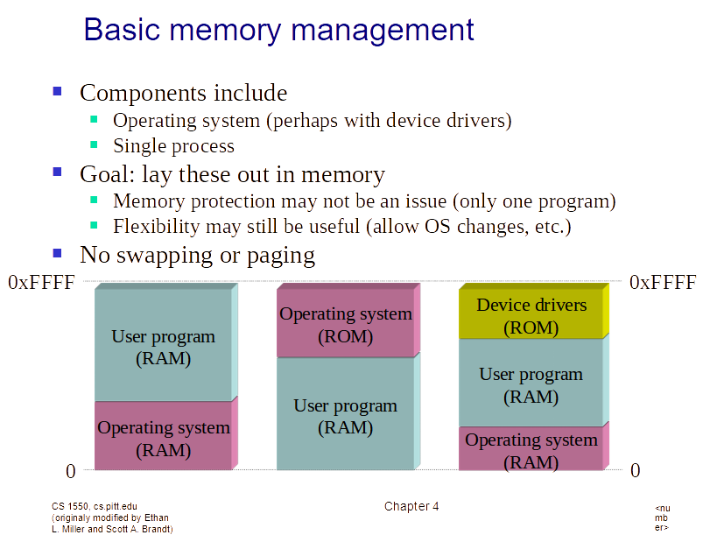

Slide 5
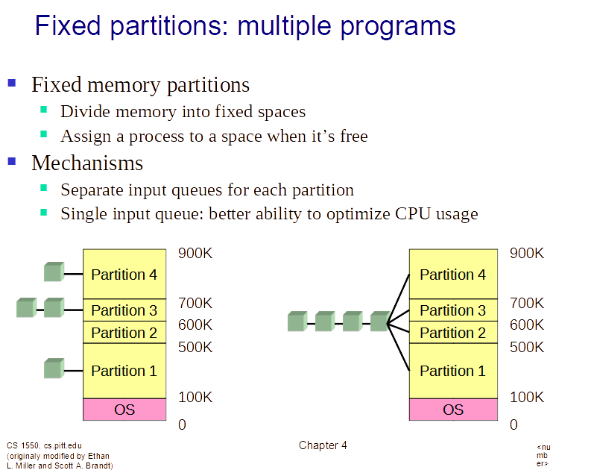

Slide 6
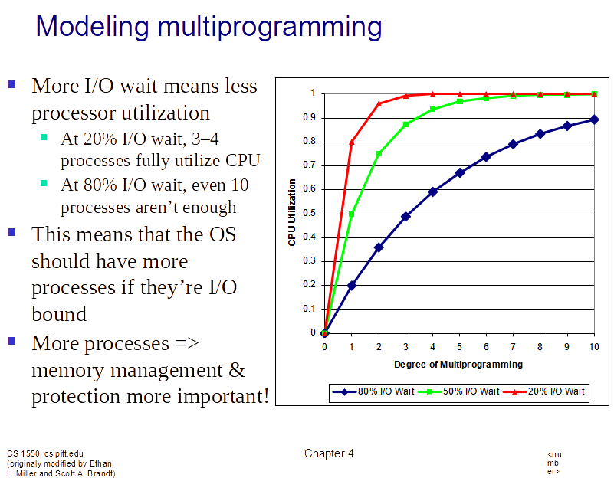
Modeling multiprogramming

Slide 7
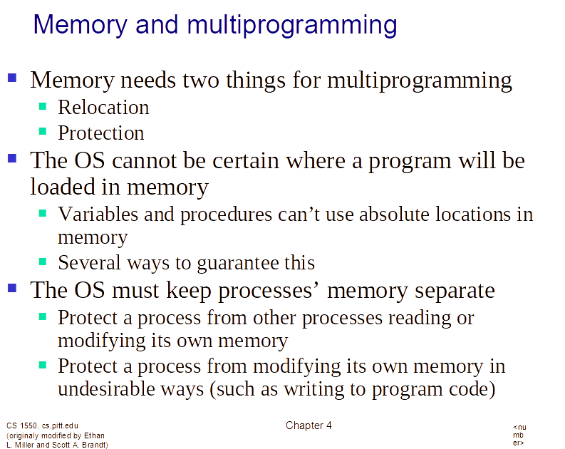

Slide 8
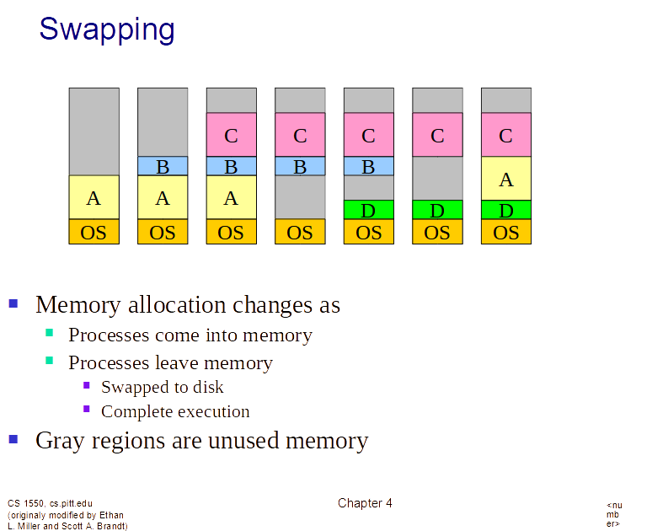

Slide 9
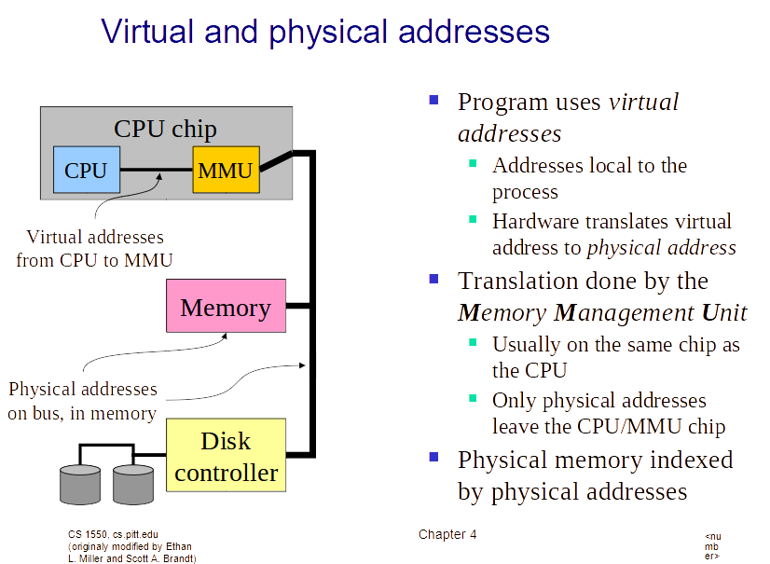

Slide 10
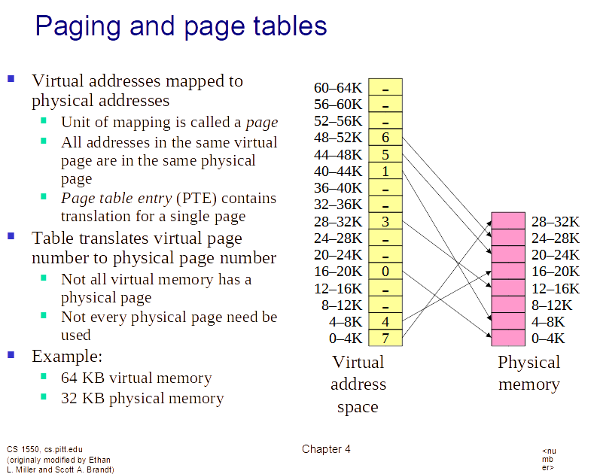

Slide 11
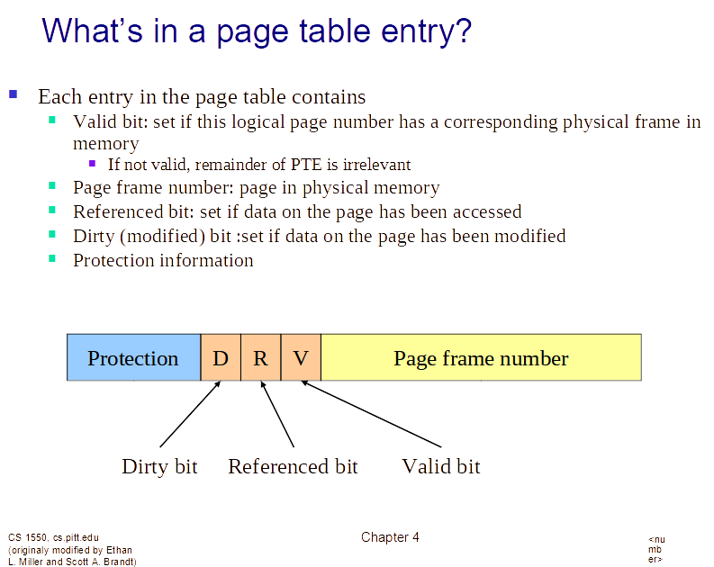

Slide 12
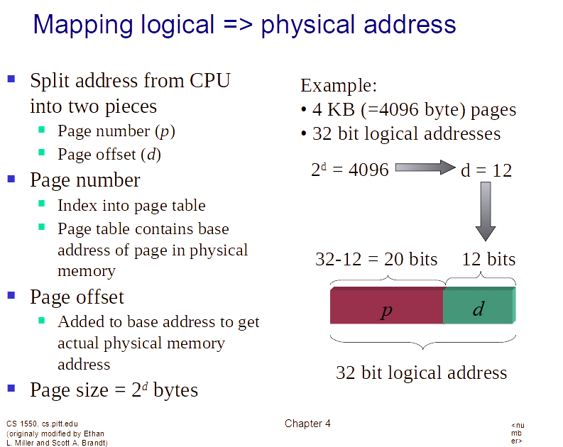

Slide 13
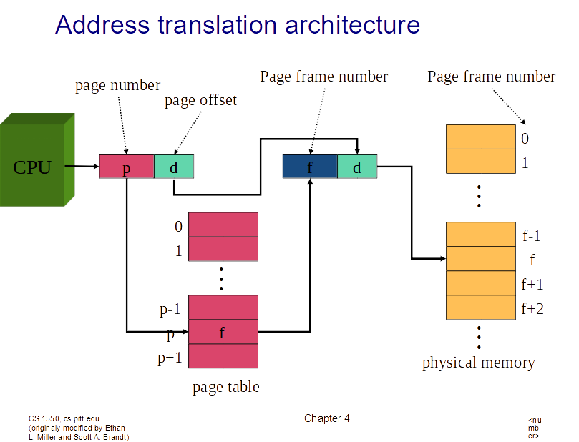

Slide 14
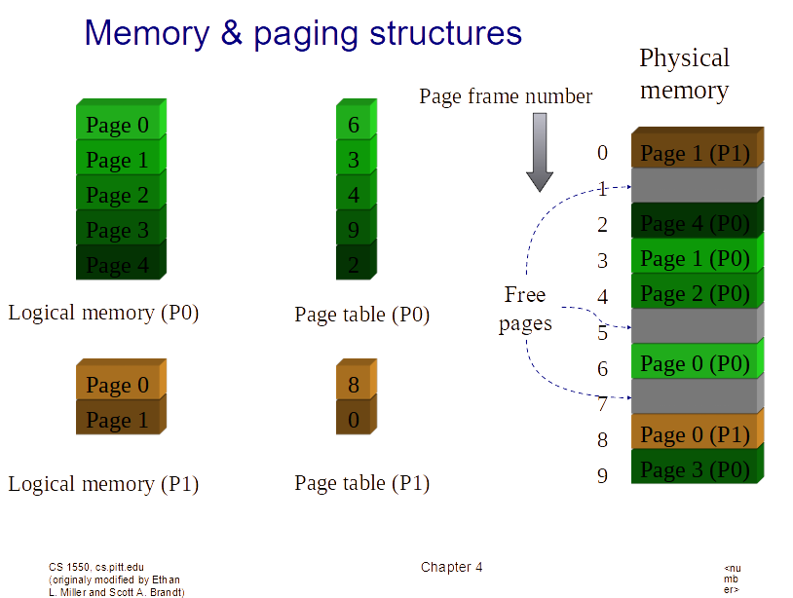

Slide 15
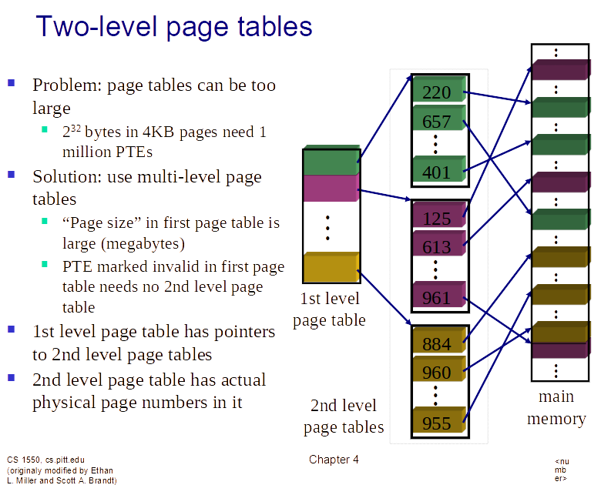

Slide 16
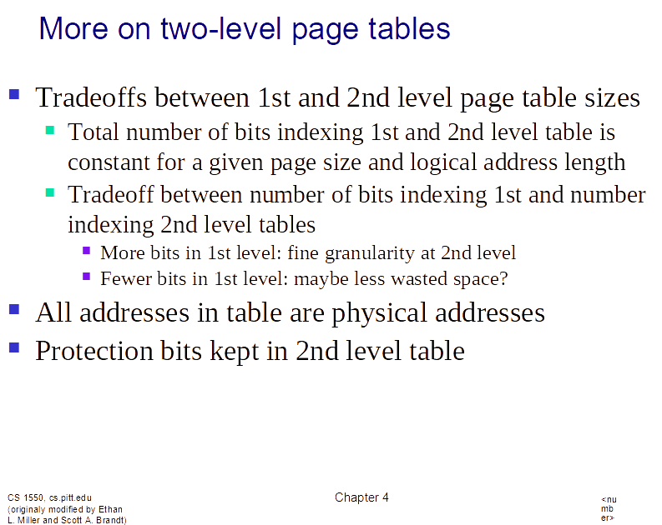

Slide 17
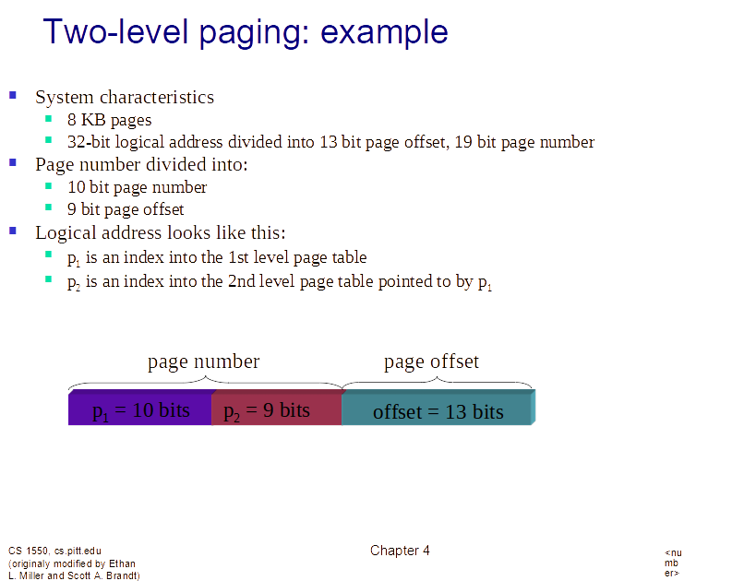

Slide 18
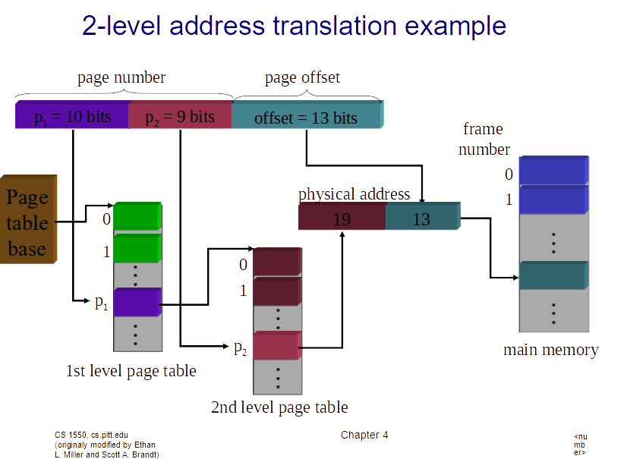

Slide 19
